Slide 1
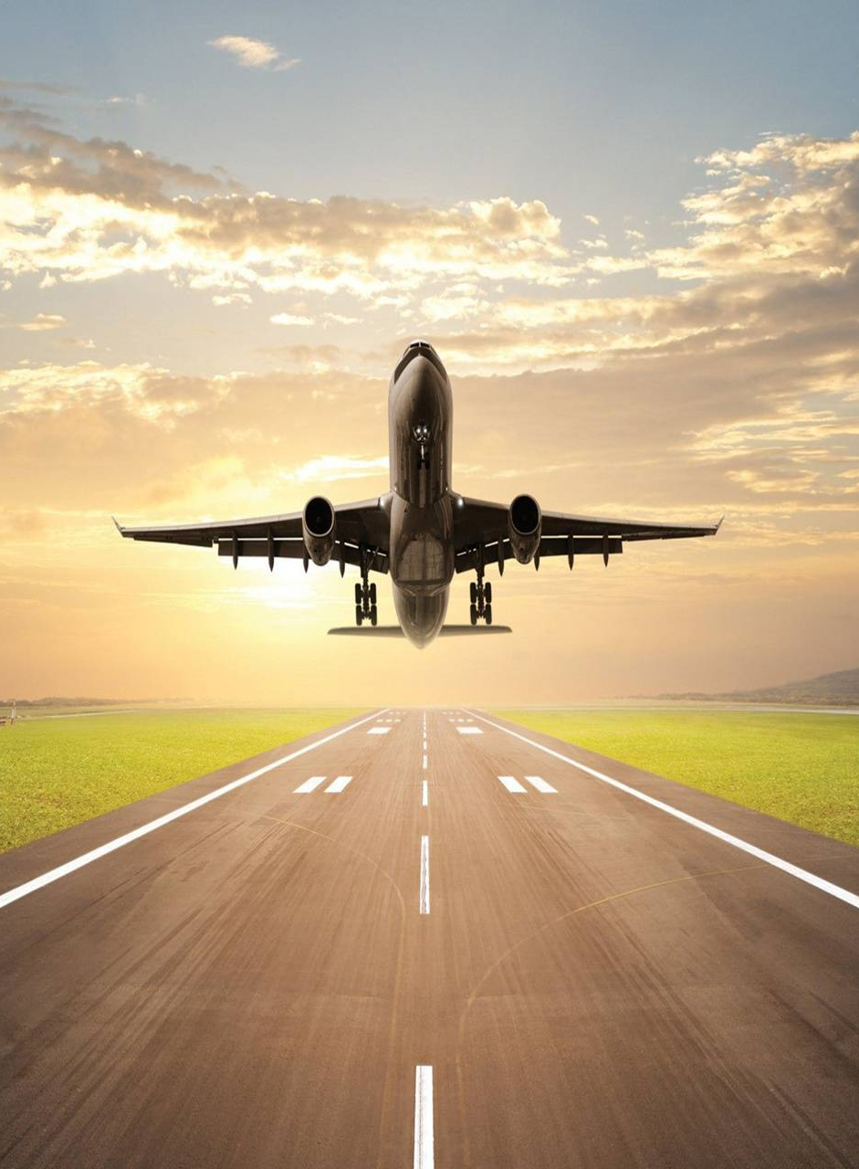
Flight Price Prediction
Submitted By:
Chaitali Mohit Nakade

Slide 2
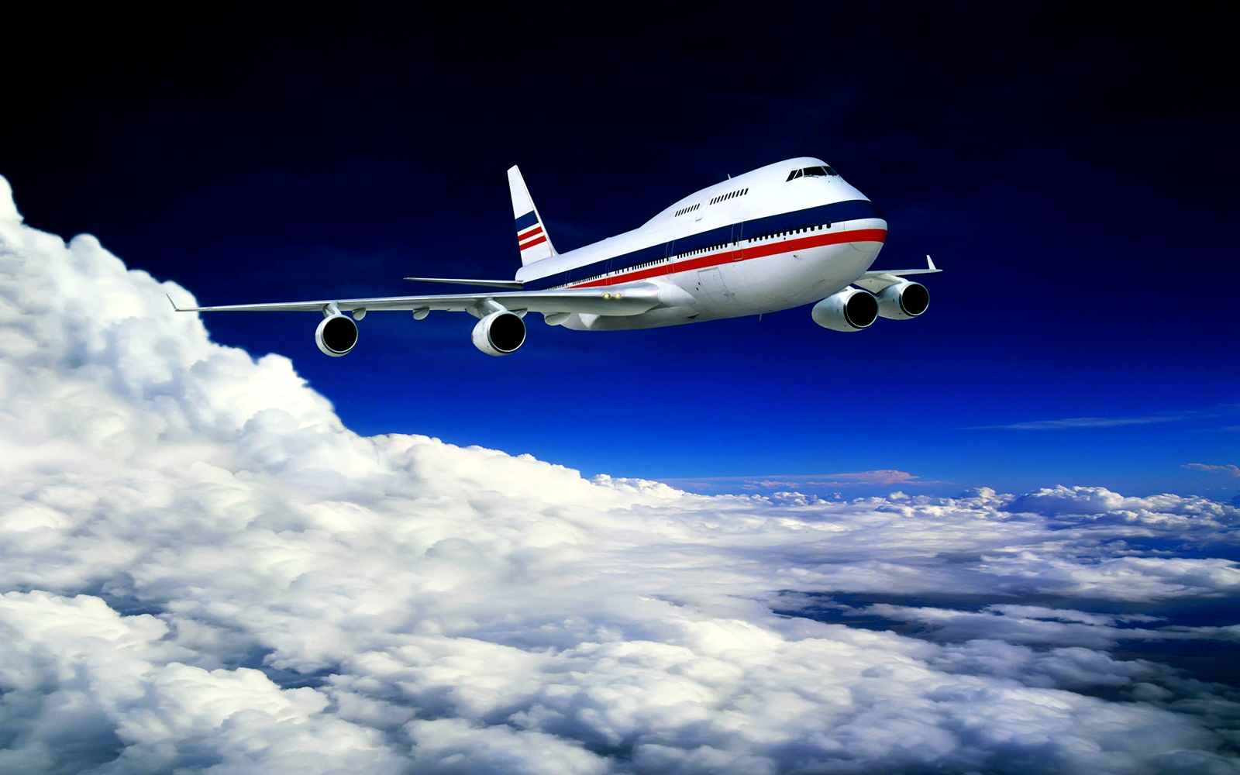
Agenda
Introduction
Problem statement
Tools used
About dataset
Data sources and there format
Data preprocessing
Outlier and skewness removal
Model building
Select best model
Hyperparameter tuning
conclusion

Slide 3
Introduction
Flight ticket price prediction is very difficult to guess.
The price of tickets will goes low and high very frequently.
With the help of machine learning we can predict the price of tickets. HOW….? So, Let’s work on flight price prediction project.
Factors which affects the prices of flights -> Date, Distance, flight time, number of stops, Duration etc.
In data collection process I had scrap the data from yatra.com with selenium and converting that data into structured format
This model is basically build on three steps:
1. Data Collection
2. Data analysis
3. Model building

Slide 4
Problem statement
The price of ticket we check today might be different tomorrow but with the help of machine learning we can predict the price of tickets. HOW….?
Anyone who has booked a flight ticket knows how unexpectedly the prices vary.
The cheapest available ticket on a given flight gets more and less expensive over time. T
his usually happens as an attempt to maximize revenue based on –
1. Time of purchase patterns (making sure last-minute purchases are expensive)
2. Keeping the flight as full as they want it (raising prices on a flight which is filling up in order to reduce sales and hold back inventory for those expensive last-minute expensive purchases)

Slide 5
Tools used
Hardware and Software Requirements and Tools Used
Notebook and Data:
GitHub, Jupyter Notebook
Libraries:
Numpy
Pandas
Sklearn
Scipy
Joblib
Matplotlib
Seaborn
statsmodels

Slide 6
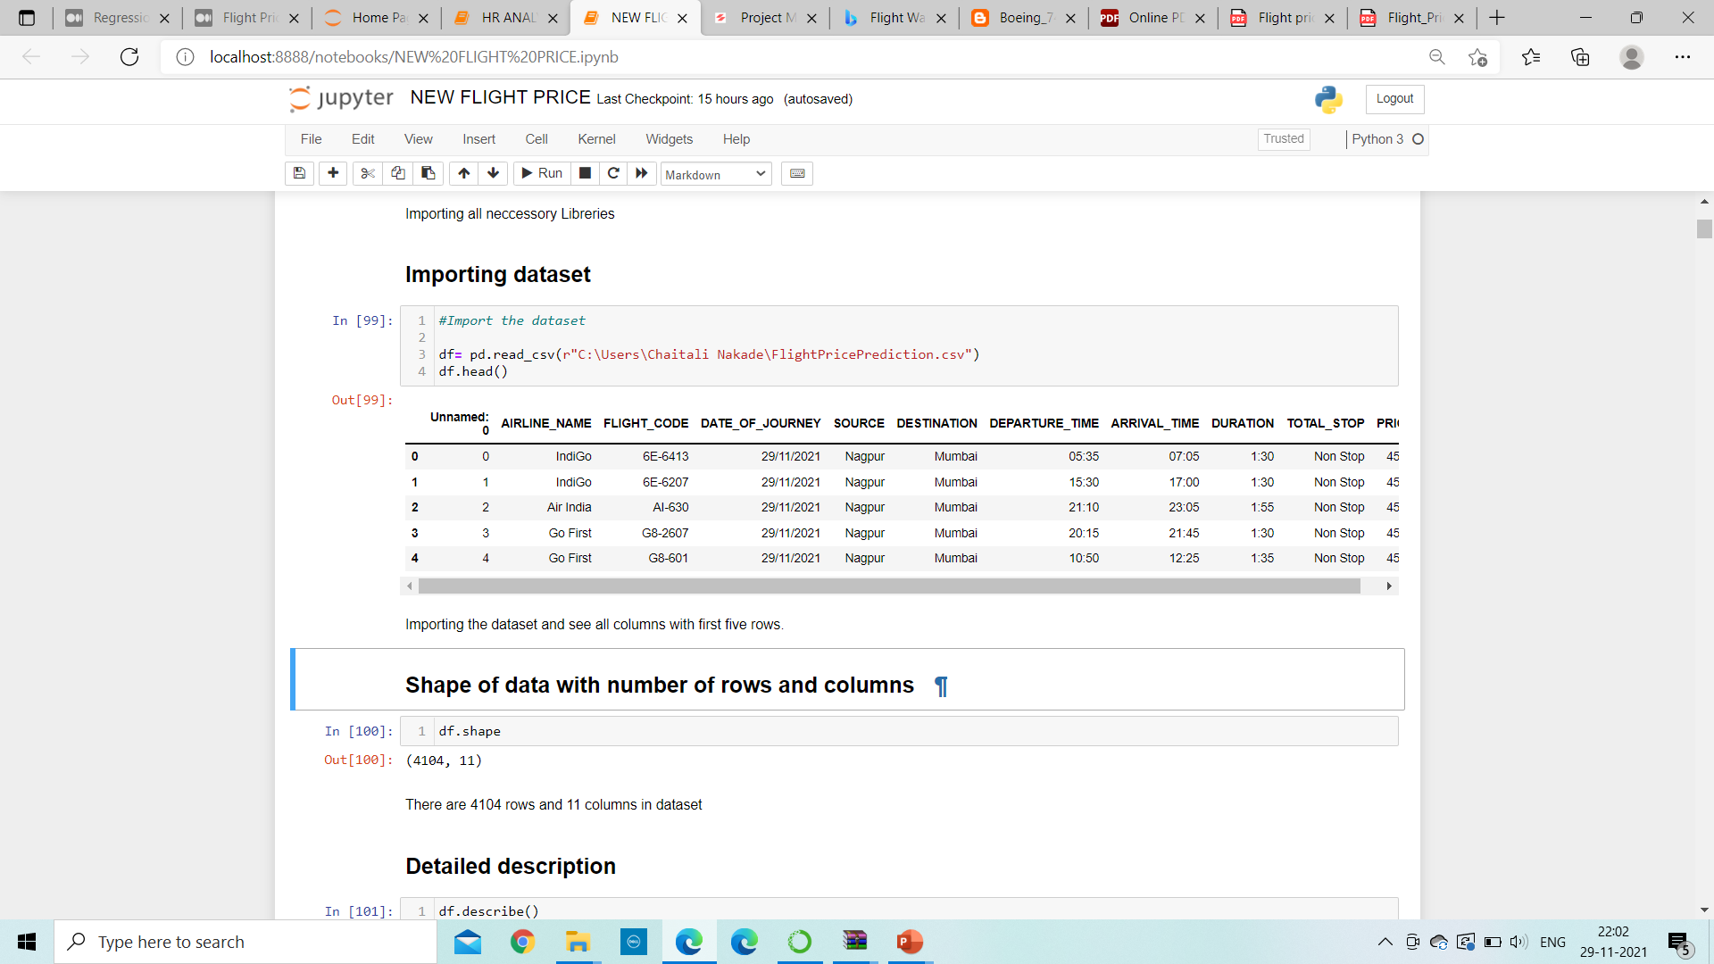
About dataset
The dataset contains 5487 rows 8 columns
Importing necessary libraries
After importing dataset the dataset will be look like,

Slide 7
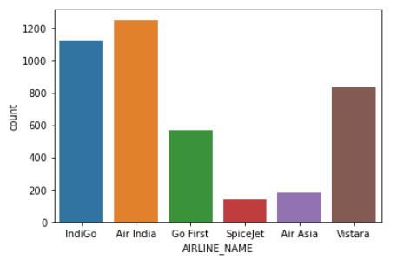
Data sources and there format
We can see there are no null values present in whole dataset.
We can find here only eight columns are having object data types and rest two columns are having integer datatype.
AIRLINE_NAME:
Air India is the most preferred airline
with the highest row count,
followed by Indigo and Vistara.

Slide 8
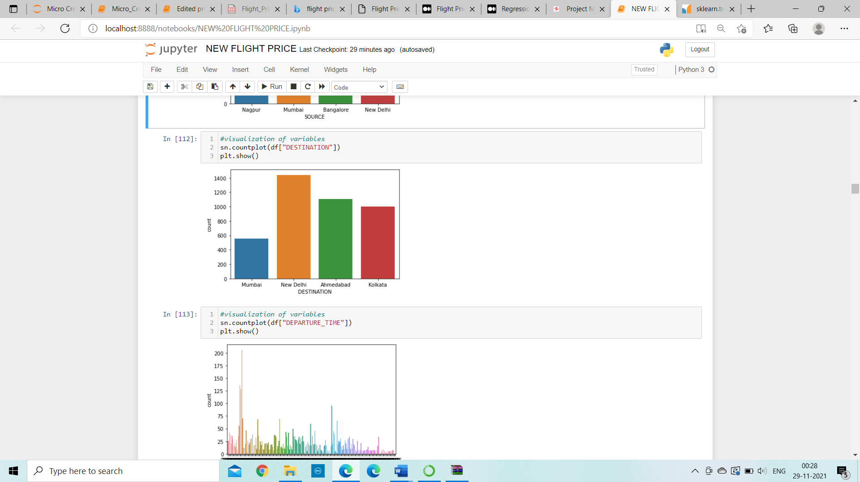
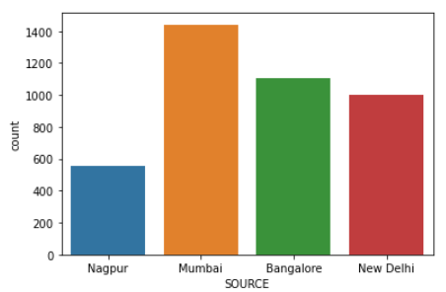
Data sources and there format continue..
Majority of the flights take off from
Mumbai followed by Bangalore.
Maximum flights land in New Delhi.
Nagpur has the lowest count of receiving
the flights compare to other.

Slide 9
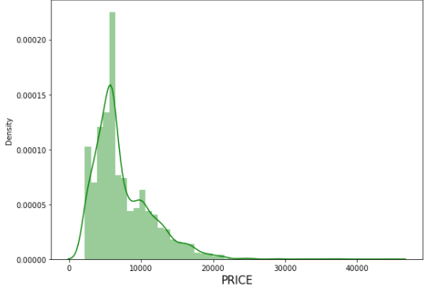
Data sources and there format continue..
The price column contains the minimum value as 2175 and maximum value as 44428. Majority of the flights have price range between 2175–20k, and number of flights having prices greater than 20k are quite less. Price range is skewed towards right.

Slide 10
Data preprocessing
Block diagram of data preprocessing
1.Drop unnecessary columns
2.Filling missing value
3.Encode the object datatype
4.Outlier detection
5.Skewness removal

Slide 11
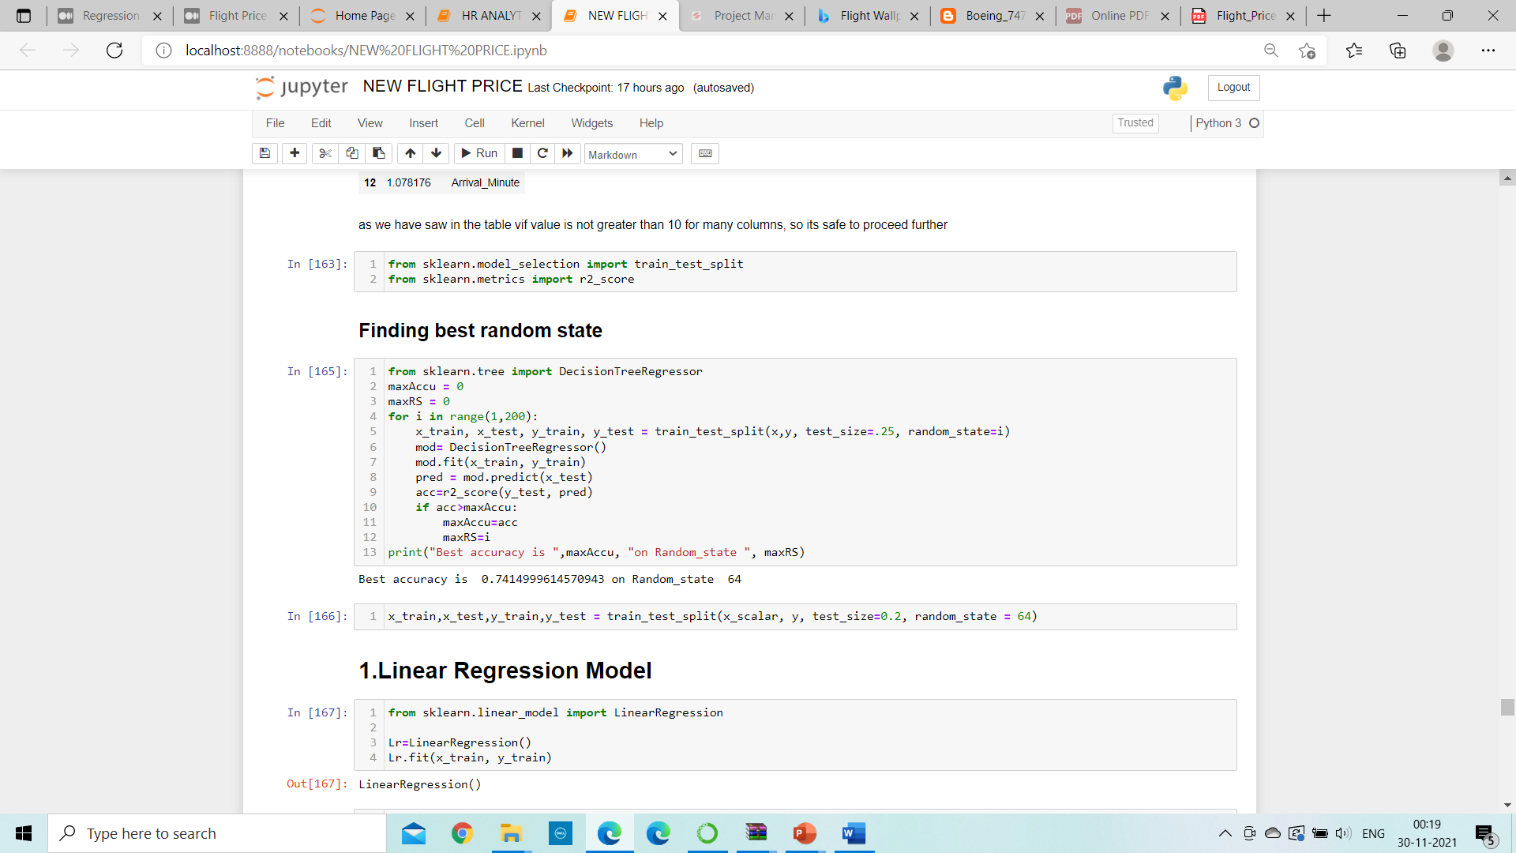
Model building
According to output best random state is
64 with 74.14% best accuracy.
Find best random state
Train test split
Model building
R2 score
Cross validation score

Slide 12
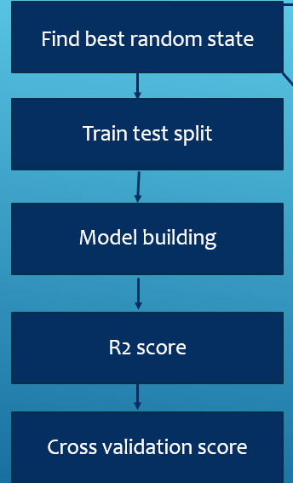
Model Building
Train test splitting of data with best random state.

Slide 13
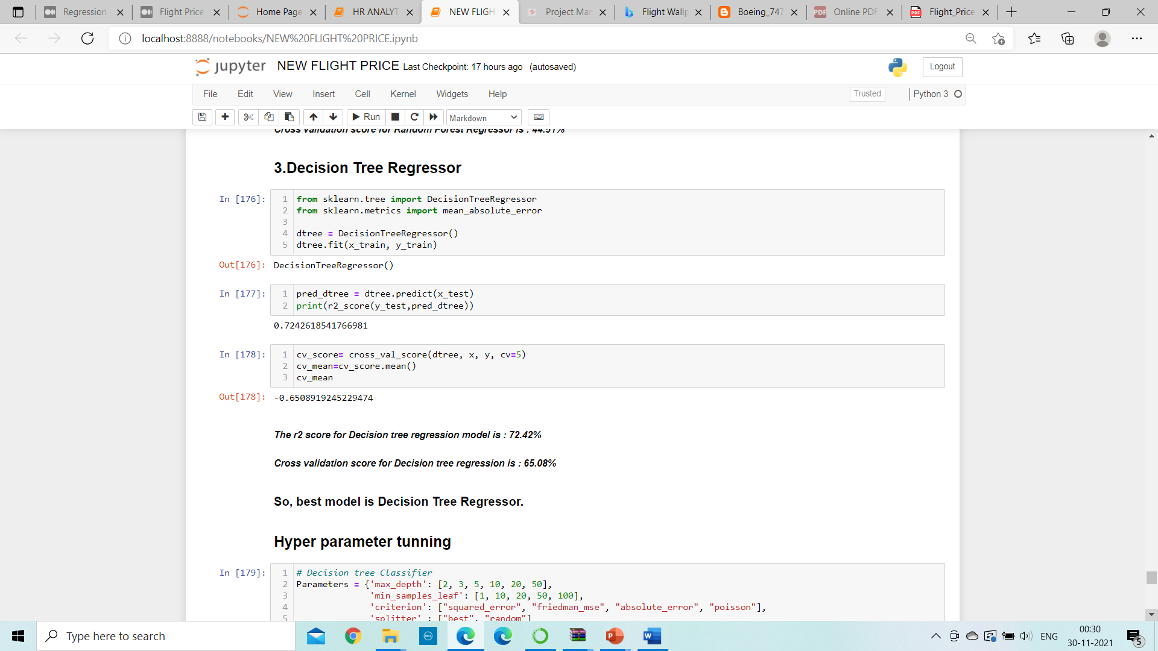
Model building

Slide 14
Selecting best model
Decision tree classifier model is having minimum difference between cross validation score and r2accuracy score, so Decision tree classifier is a best model
Sr. No. | Algorithms | Accuracy score (a) | Cross -Validation Score(b) | Difference (a-b)
1. | Random forest regressor | 82.89% | 44.51% | 32.42 %
2. | Decision Tree Regressor | 72.42% | 65.08% | 6. 34%

Slide 15
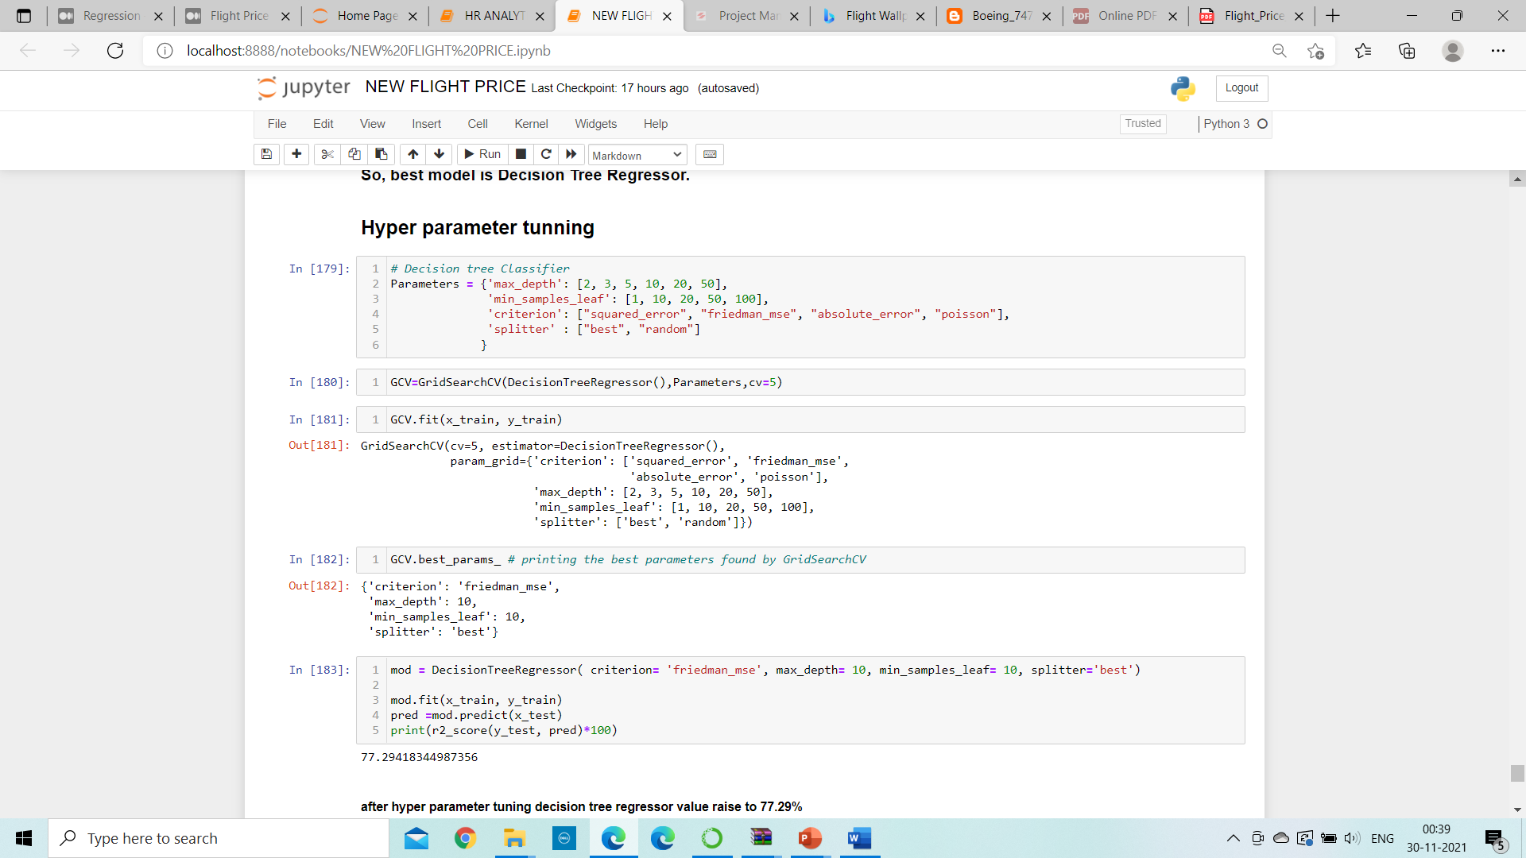
Hyperparameter tuning
Grid search cross validation (GCV) in hyperparameter tuning will help us to finding the best parameter and tune it with training data set and give best accuracy score
After hyperparameter tuning the accuracy score is raise to : 77.29%

Slide 16
Conclusion
Hence, at the end, we were effectively able to train our regression model ‘Gradient Boosting Regressor’ to predict the flights of prices with an r2_score of 77%, and have achieved the required task successfully.

Slide 17
THANK YOU

